Slide 1
On embedding a traditional mechanical engineering
course in a constructivist learning environment
Thorsten Bartel
IEEE German Education Conference 2022  Berlin  11./12.08.2022

Slide 2
Motivation
Why do we need constructivist learning environments in engineering education?

Slide 3
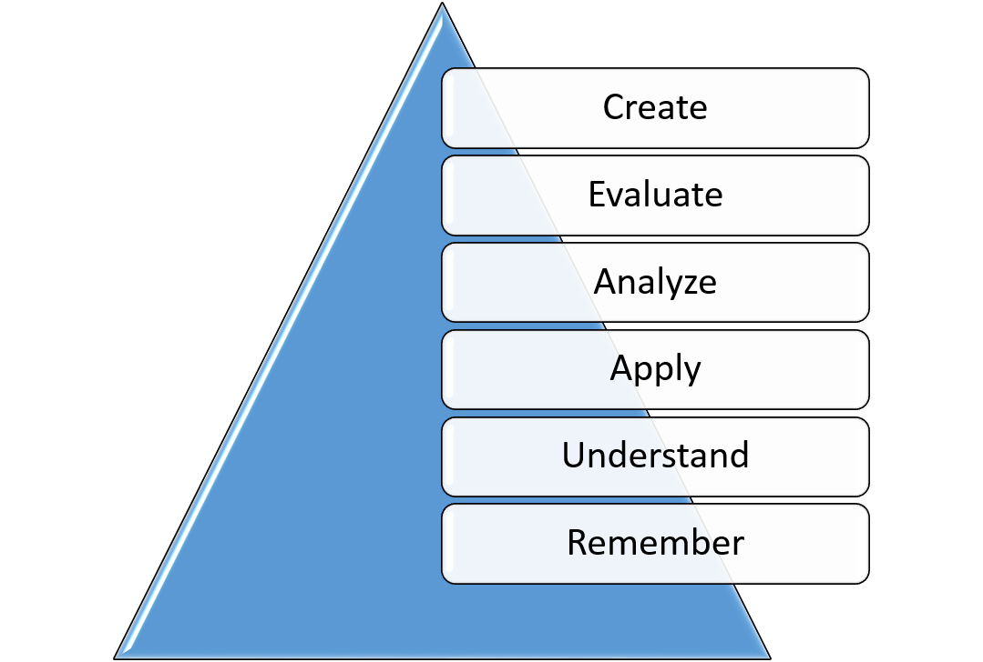
Challenges in engineering
Modelling
Aims
System design
Calculation/Simulation
Computer aided simulations
Methodology
Analysis/Evaluation
Analysis of results
Design evaluation
Digitization
Accuracy vs. Efficiency
Professional requirements
Learning outcomes

Slide 4
Methodology and implementation
How to embed a traditional mechanics module into a constructivist setting?

Slide 5
“Machine Dynamics“

Slide 6
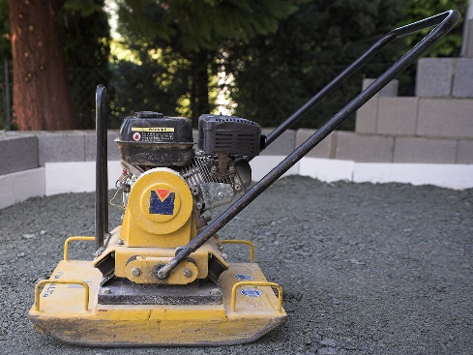
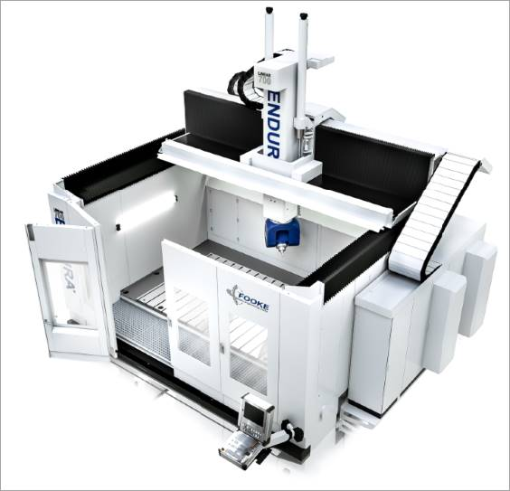
Adapted teaching content
Image from https://commons.wikimedia.org/wiki File: Plate compactor.jpg. Copyright CC BY-SA 3.0.
Image from https://commons.wikimedia.org/wiki File: Wind turbine construction, Pougny, E10-01.jpg. Image cropped to the area of the tower. Copyright CC BY-SA 4.0.
Courtesy of Svenja Drücker, Institut für Mechanik und Meerestechnik, TU Hamburg.
Courtesy of Fooke GmbH

Slide 7
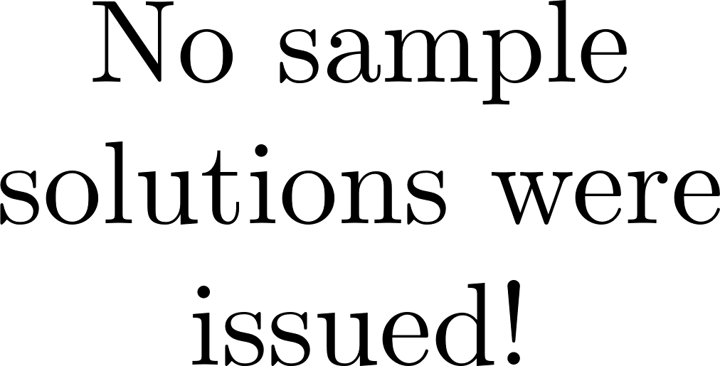
Core concept

Slide 8
Data collection and evaluation
How was the new concept received by the students?

Slide 9
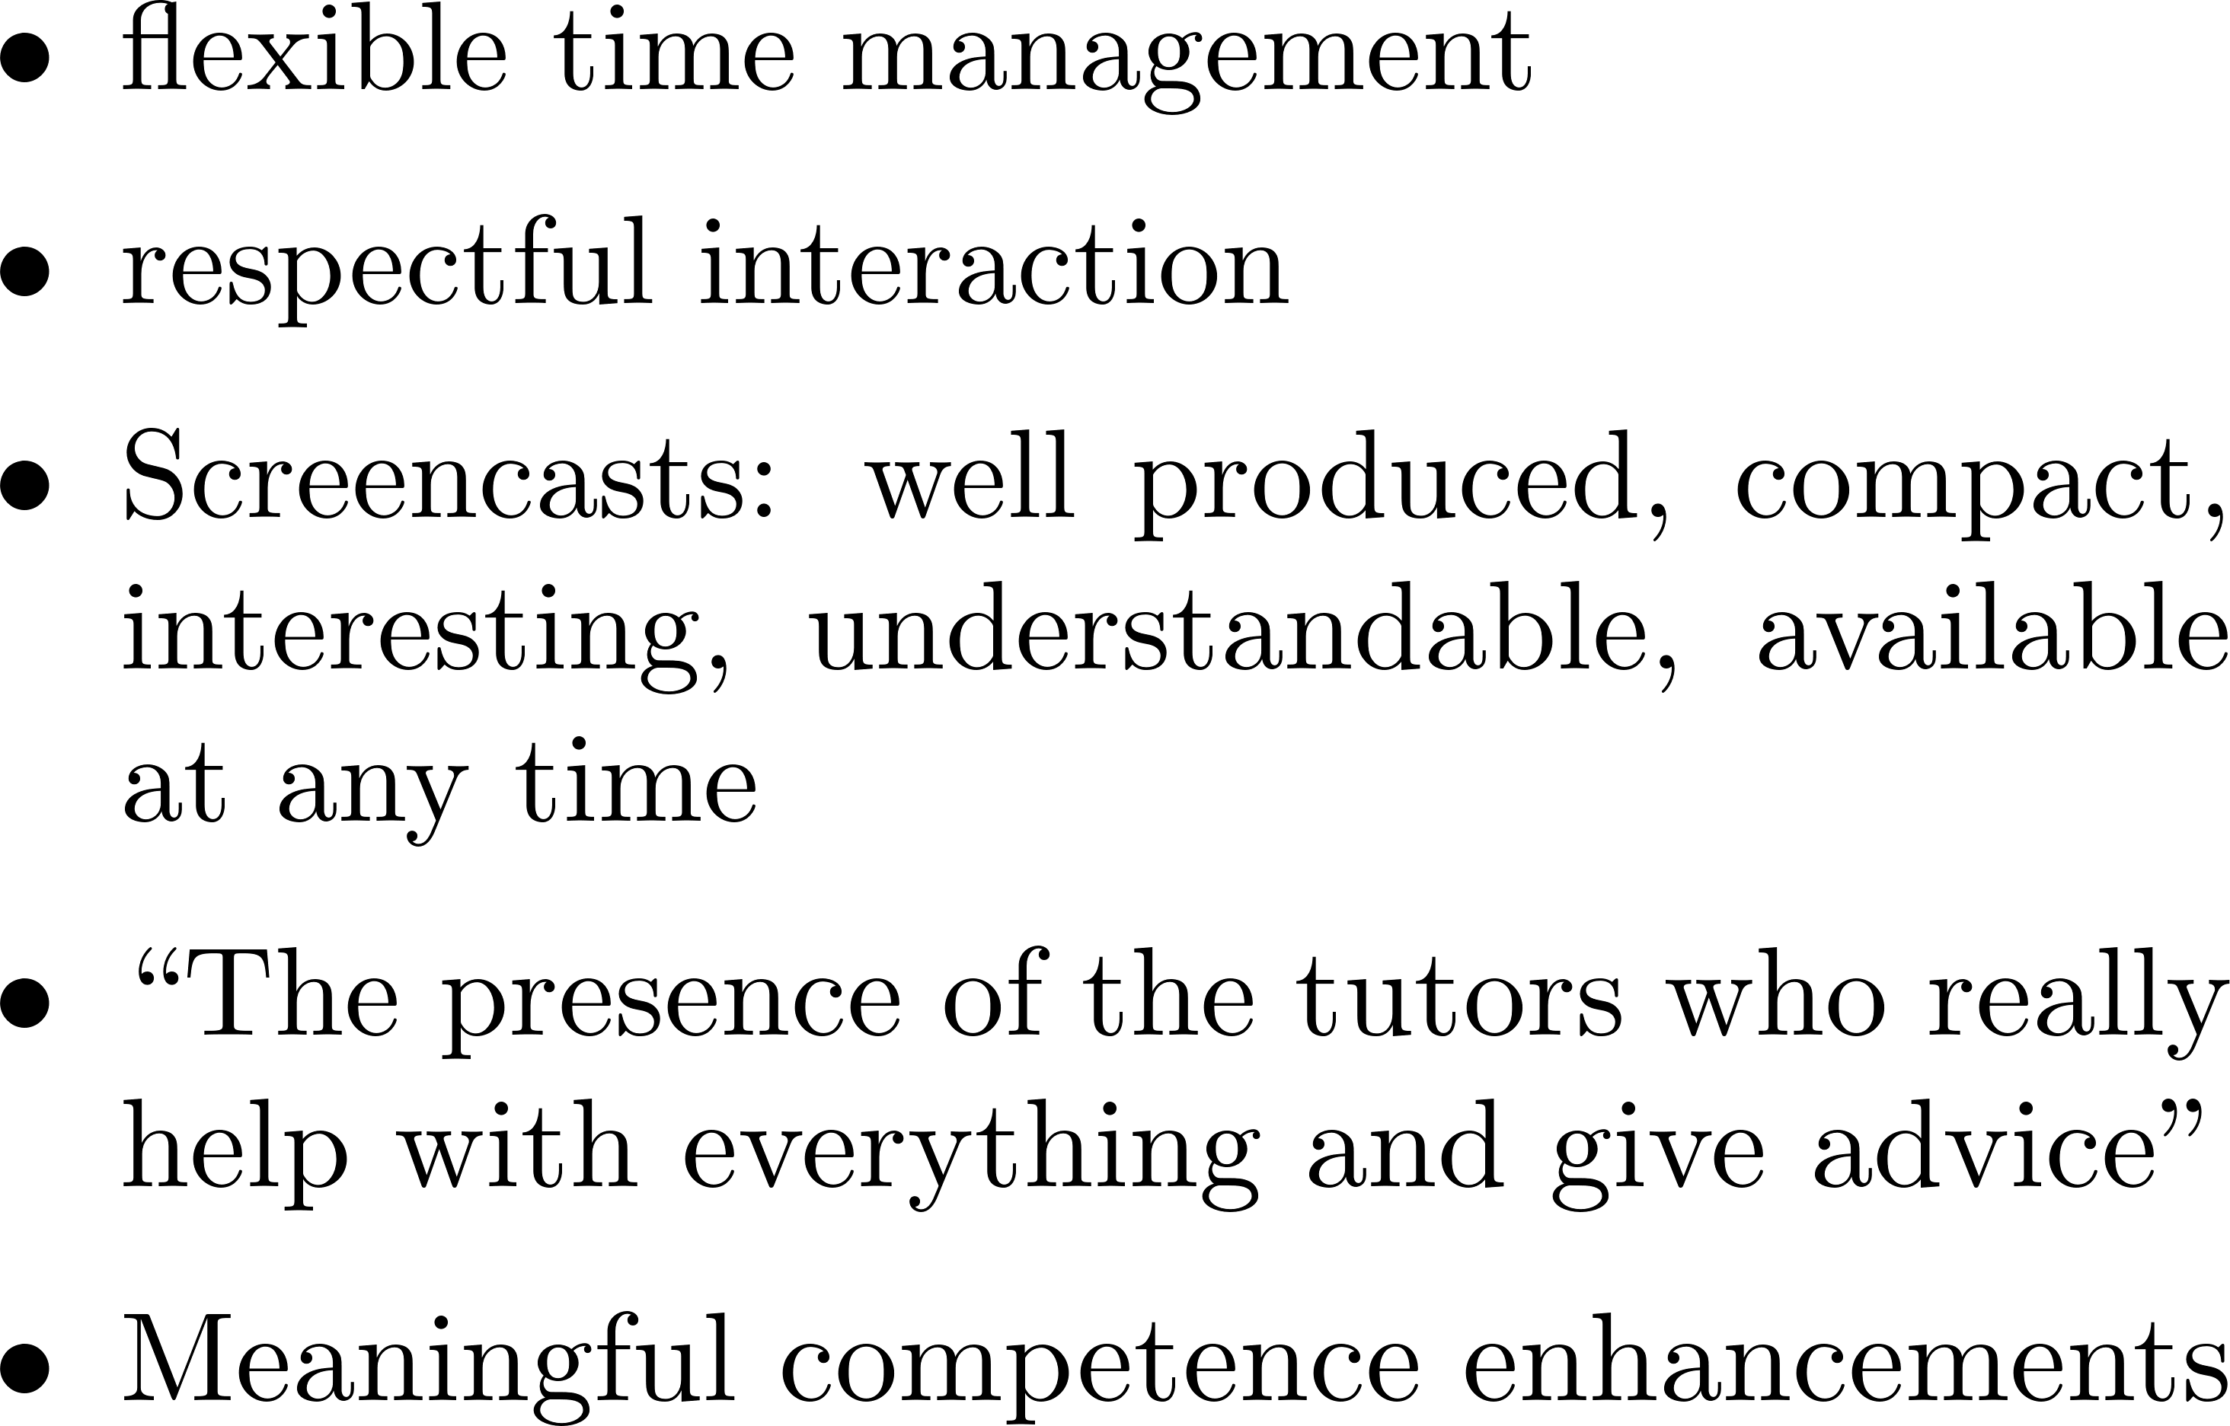
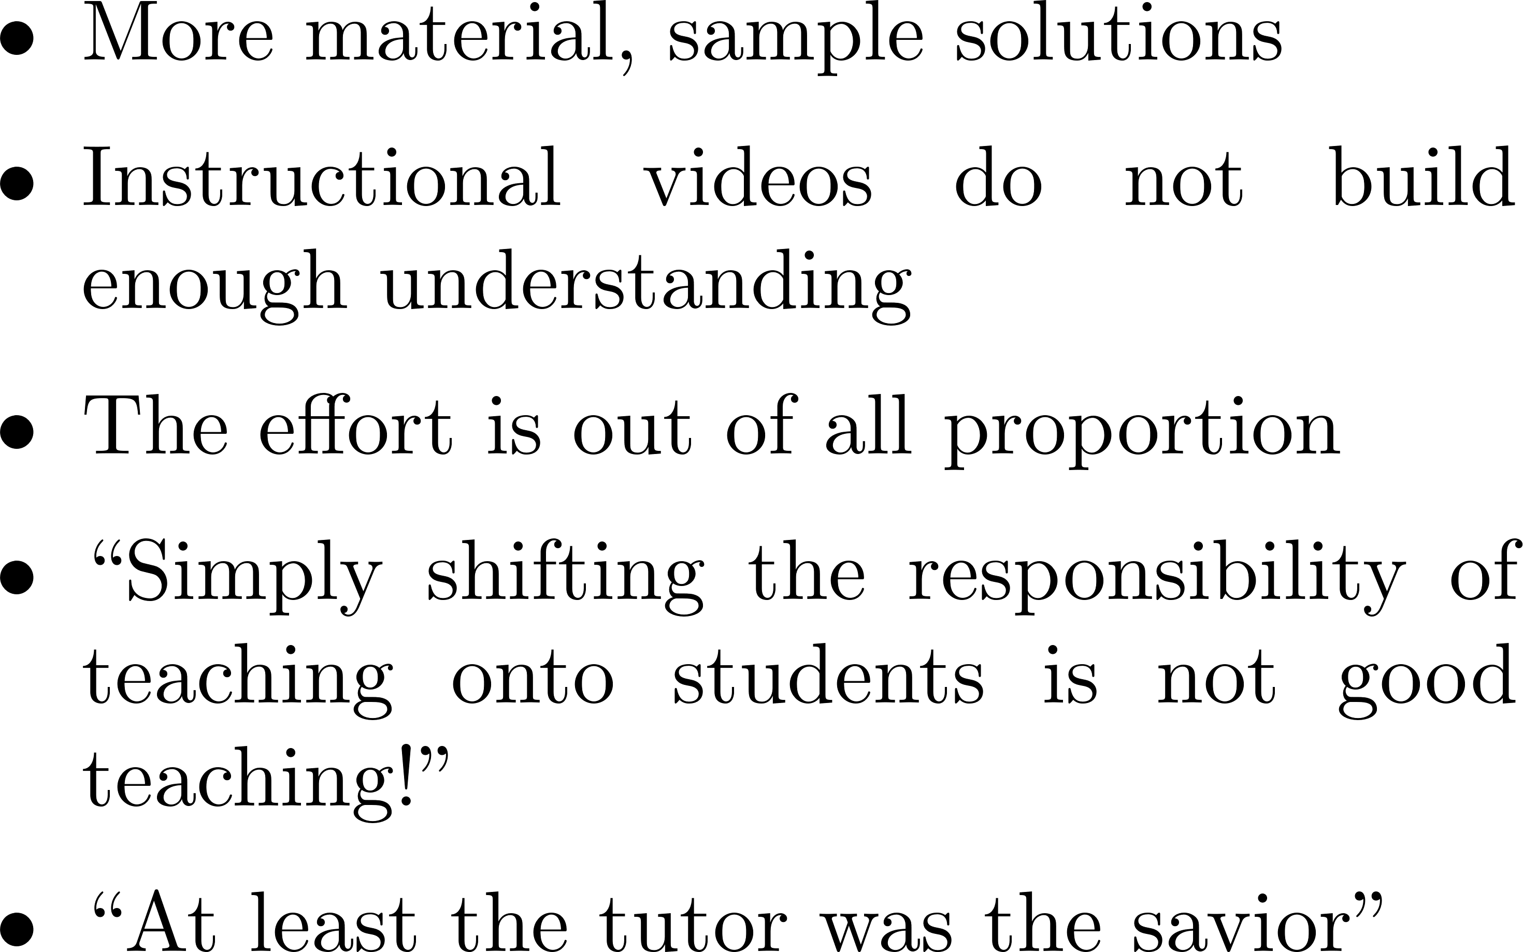
Teaching evaluation – Selected feedback

Slide 10
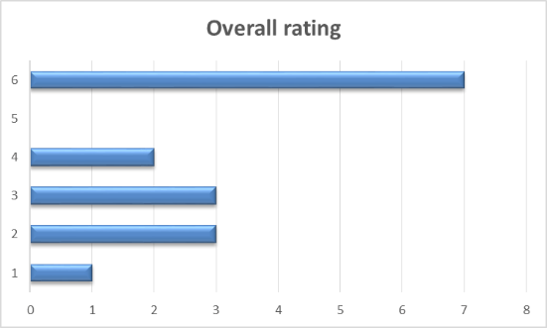
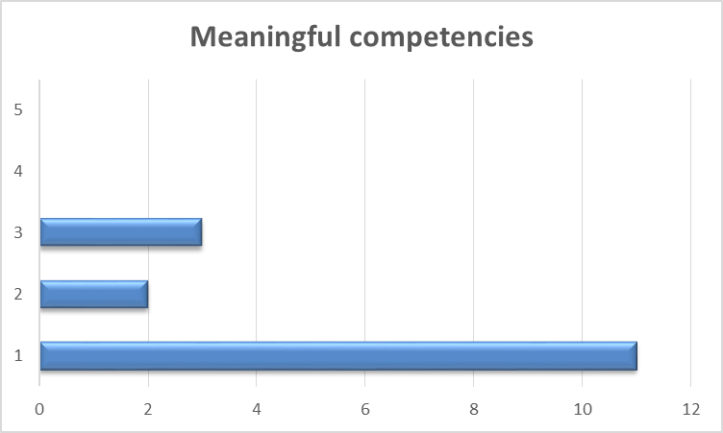
Teaching evaluation – Selected feedback

Slide 11
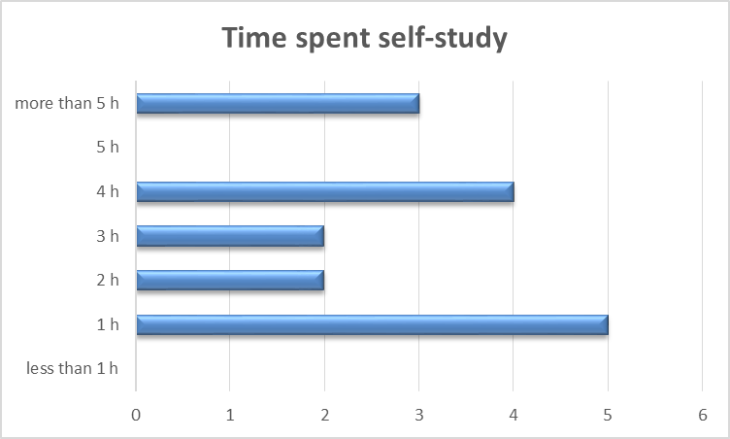
Teaching evaluation – Selected feedback

Slide 12
Conclusion and outlook

Slide 13
Personal Retrospective

Slide 14
Conclusion and outlook

Slide 15
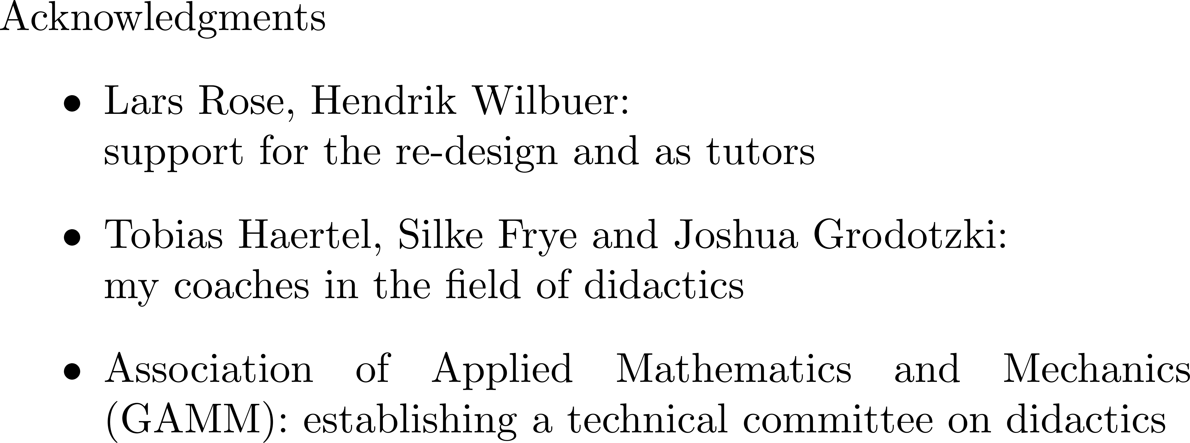
On embedding a traditional mechanical engineering
course in a constructivist learning environment
Thorsten Bartel
IEEE German Education Conference 2022  Berlin  11./12.08.2022

